Slide 1

Version Control- Git
Steps on using git for version control with GitHub/DevOps.
This is for code related files.
Difference between git and Github: git are like photos while Github is the photo album.

Slide 2

Why use git for coding? TRACK CHANGES!
Why git
Can show file differences
User has to update manually thus more control
Great environment to track changes for collaboration through pull request and branches.
Why not use onedrive or sharepoint?
Limited version control; does not show where edited in file, automatically updates without user’s discretion.
Difficult environment to track changes for collaboration
BUGGYYYYYYY ASF

Slide 3

Git Commands
TBH git commands are a lot at first. We will use these today:
git pull
git add
git commit
git push
git status
For more info use this book: https://happygitwithr.com/
We will be going over chapter 11.

Slide 4
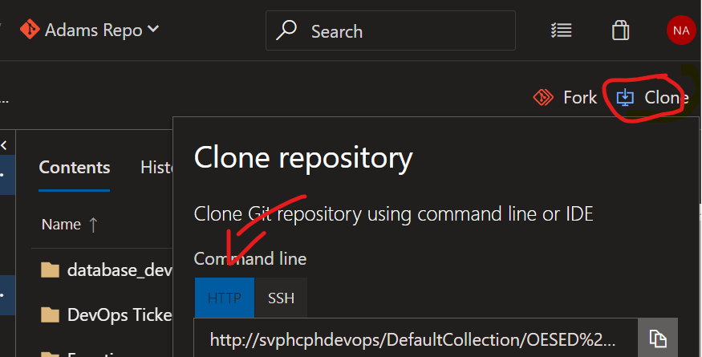
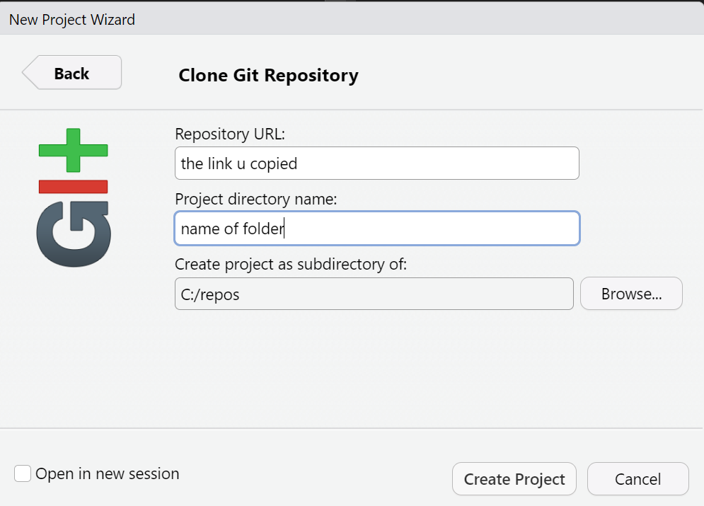
Lets do it:
Download git: https://git-scm.com/
Create a repo in GitHub/DevOps or use existing repo in Github/Devops
(I will use DevOps in my demonstration)
In the top right of webpage of repo, click clone then copy the http link.
Open Rstudio, in top left corner click “File” then click “New Project”.
A wizard should pop up then click on “Version Control”
Then select “Git”
Then paste your HTTP link into “Repository URL” and select where you would want your folder. DO NOT PUT IT IN A ONE DRIVE FOLDER.
I like to put it in a new folder under my “c:/” directory.

Slide 5
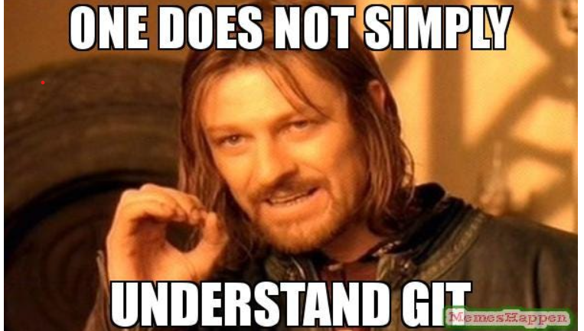

The END
I will demonstrate my workflow….
Pls refer to recording…
Practice it in your coding workflow when u have time
Cant learn it all overnight….
If u do please fix my future merge conflicts
Good luck o7

